Slide 1
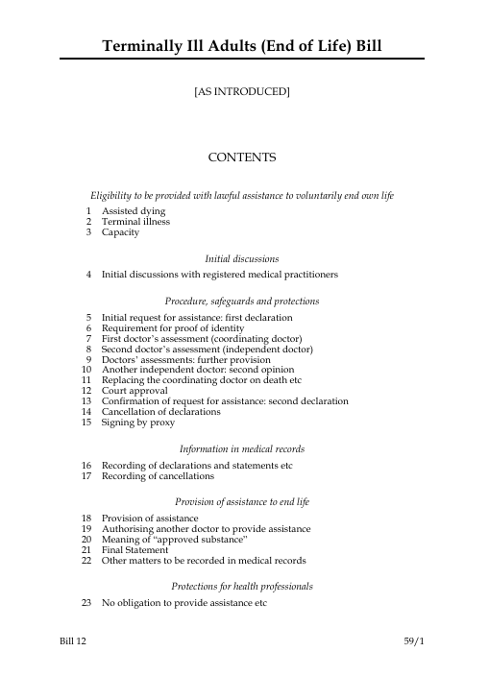
Terminally Ill Adults Bill 2024-25
‘To allow adults who are terminally ill…. to request and be provided with assistance to end their own life…..’

Slide 2
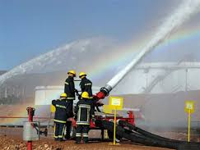
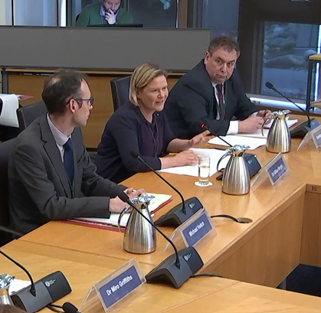
Consultation and live bills around the UK
Jersey
Isle of Man
Scotland
Westminster: England & Wales

Slide 3
Westminster ‘TIA Bill’
1st Stage 16 October 2024 – 11th November
2nd Stage November 2024
2nd Reading in House of Commons 29th November
Bill passed 330:275
Committee Stage January 2025
6th call for written evidence
21st 1st sitting
28-30th oral evidence
Report stage: March 3rd Reading: 25th April 2025

Slide 4
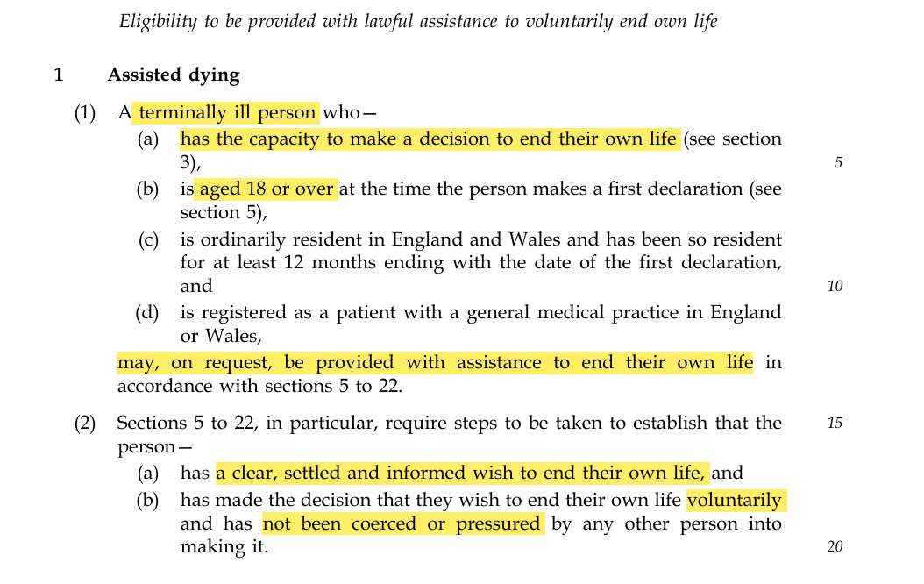
Westminster

Slide 5
TIA Bill in brief
Capacitous adults > 18yrs
Resident in England/Wales
No coercion or pressure ‘by any other person’
Terminal illness ‘inevitably progressive illness … cannot be reversed by treatment …
death reasonably expected within 6 months’
Excluding ‘mental disorder’ or ‘disability’
No obligation for a doctor to discuss the option with eligible patients (?)
‘must … refer … to another … medical practitioner …
[who] is willing and able to conduct … discussion’

Slide 6
TIA Bill - process
‘First declaration’
‘First assessment’ (coordinating doctor)
refer to ‘the independent doctor’
‘First period of reflection’ = 7 days
‘Second assessment’ (independent doctor)
High Court Declaration
‘Second period of reflection’ = 14 days (or 48hrs)
‘Second declaration’
‘Final statement’

Slide 7
Assessments
Assessments include discussion:
diagnosis + prognosis
available treatment + likely effect
available palliative care / hospice care / other care
nature of ‘the substance’
wishes in case of complications
ask patient to inform GP and D/W family
May refer to psychiatrist (re capacity)
May refer to somebody with experience of that condition

Slide 8
Coordinating doctor
Coordinating doctor
provides approved substance
directly and in person
prepare the substance for self-administration
prepare a medical device to enable self-administration
assist person to ingest / self-administer
Remain [in same building]
until person has died
procedure has ‘failed’
until person has decided not to take approved substance

Slide 9
Reporting
Death certificate
1a = Assisted death
? 1b = diagnosis
Annual report to Parliament
CMO must
monitor
investigate
Report (Parliament + Senedd)
After 5yrs
Review of The Act
Assessment of P+EoLC Services

Slide 10
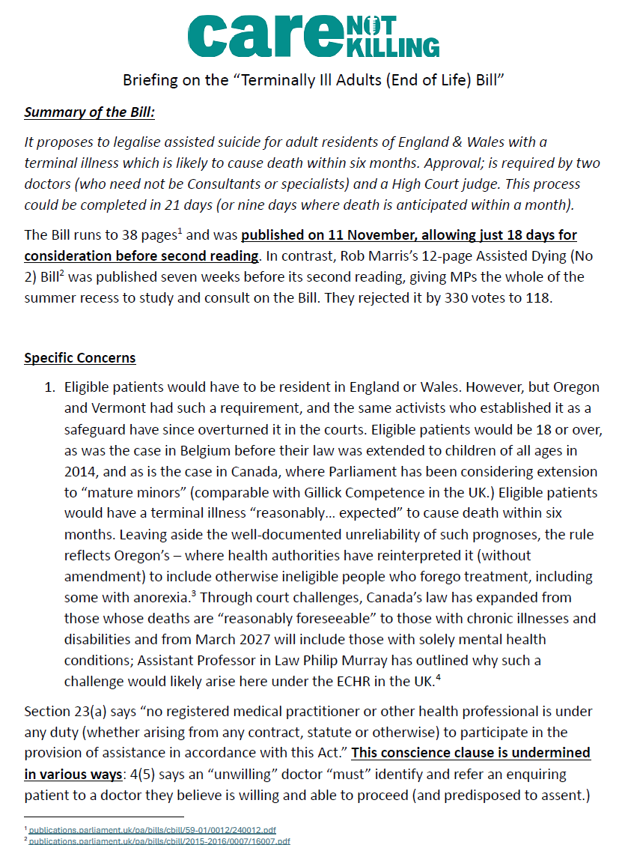
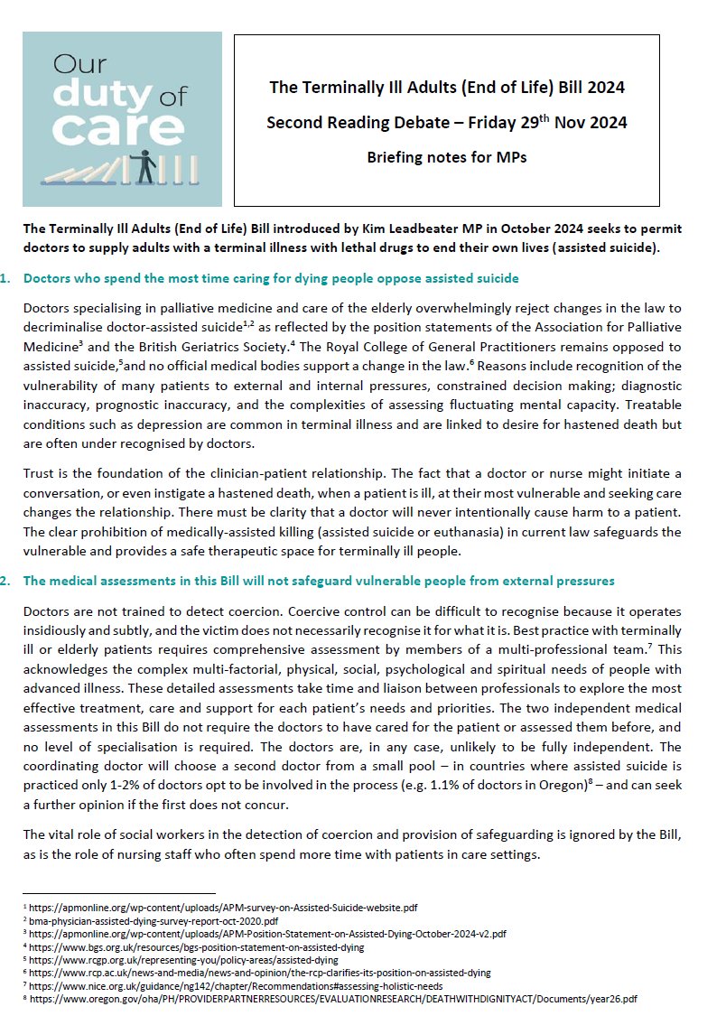
Concerns - extensive
Risks to vulnerable people
Medical assessments are not safeguards
Legal hurdles are not safeguards
Assessing capacity and coercion
Prognostic inaccuracy
Conscientious objection
No guarantee of a dignified death
Almost complete lack of evidence base….
…so much more that palliative care vs offer
Impact on suicide prevention
Safeguards cannot prevent future
expansion beyond ‘terminal illness’
Risks to palliative care services
Impact on society?

Slide 11
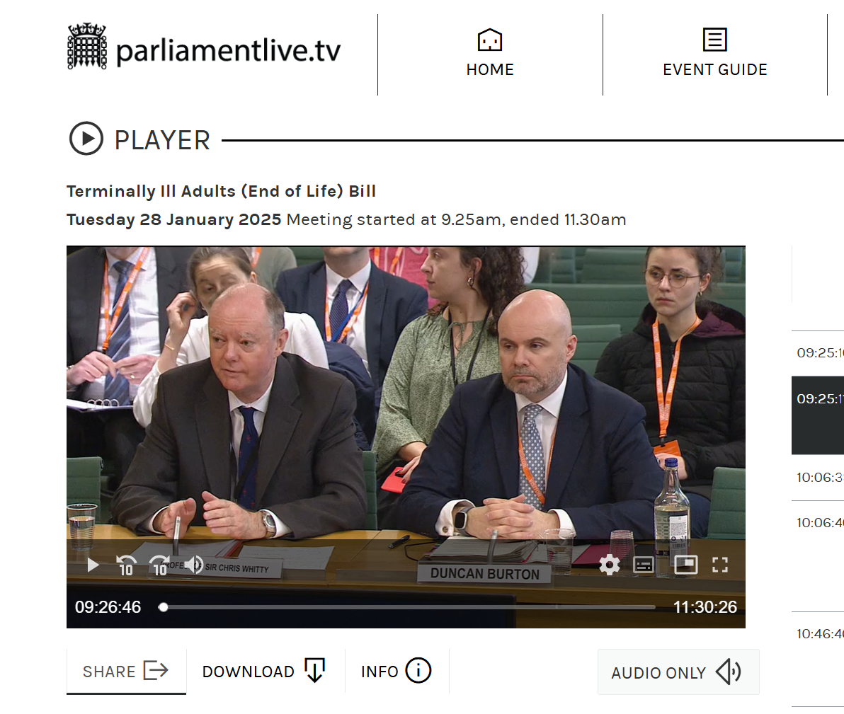
Committee stage – oral evidence
40 minutes for the CMO & CNO
30 minutes BMA & GMC

Slide 12
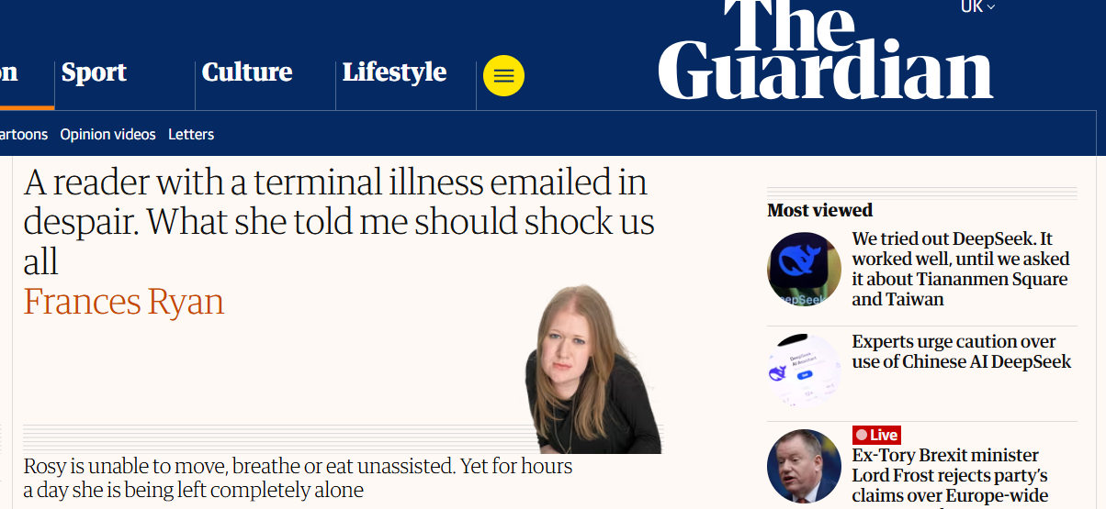
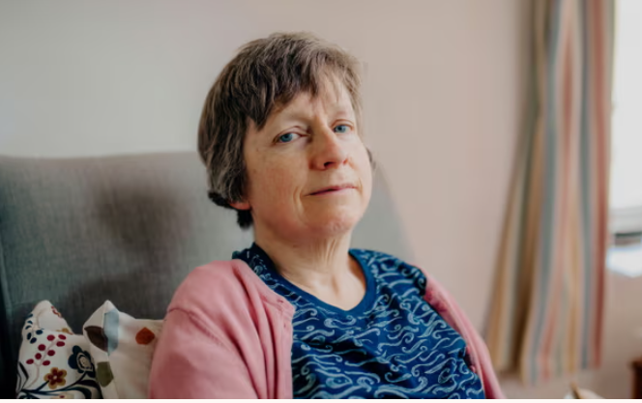
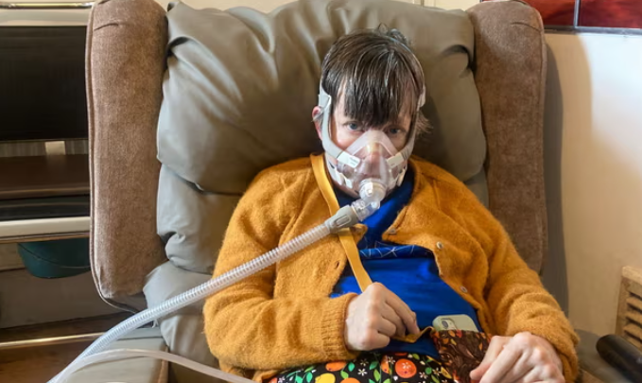
Can the choice to live or die truly be “free” whilst health inequalities exist?
Message to our MPs….
Concentrate first on ‘Assisted Living’

Slide 13
‘Learn from our mistakes’
Few Canadian doctors foresaw that 'going neutral' would guarantee the arrival of euthanasia, or that promises of a shot in the arm for palliative care would be forgotten. Even fewer realised they would have no option but to cooperate with providing death on demand. It has become all too easy to end patients’ lives.
Dr Will Johnston, Family Physician and Professor, Canada
(BMJ 2019;364:l412)

Slide 14
Any questions?
connect@ourdutyofcare.org.uk
info@ourdutyofcare.org.uk

